Slide 1
ADIP 2016 Final Project
105318032 賴笙昊
105318036 洪育佳
指導教授：張文中 老師

Slide 2
Outline
Introduction
Process
Theories
Experiment results
Conclusion
Reference
Contribution

Slide 3
Introduction
This final project introduce a method of image processing. We code this program on Visual Studio 2012 and basically use in C with the library of OpenCV. Users can input an image, then select a kind of modes. There are three modes, the first one is no-light mode, the second one is light mode with books, and the third one is light mode with papers. When the users choose a mode, system will target the front cover of the book or paper and calculate the time during the process.
Notes:
本篇文件是介紹一款影像處理的程式，此程式透過Visual Studio2012平台以及OPENCV程式庫為基礎所撰寫出來的一款C語言程式，使用者可給予一張影像，並選擇三種模式：第一種模式為無光處理，第二種模式為有光書本，第三種模式為有光紙張。使用者可自行判斷所需要的模式，系統會將影像中的文件或書本封面標記出來並顯示出運算時間。

Slide 4
Process
First, we transfer the image from RGB to gray level, and then do Power-Law transformation to calibrate image’s brightness. After that, we do morphological methods such as dilation and erosion to remove the high frequency signals. Next, we can find the edge of the book’s or paper’s front cover then pick up four points which are corners of the front cover. Therefore, we get four points to do perspective transformation.

Slide 5
Theories
Power-Law transformation
Thresholding
Topological structural analysis
Douglas–Peucker algorithm
Perspective transformation

Slide 6
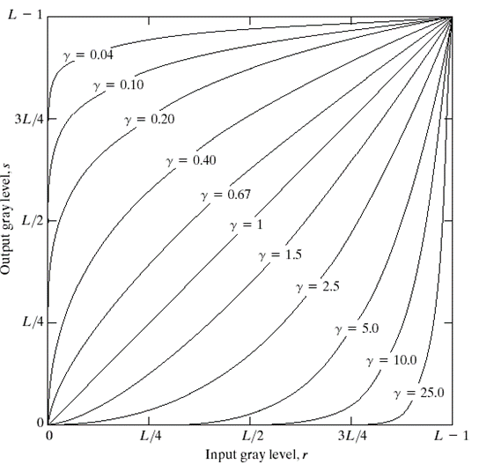
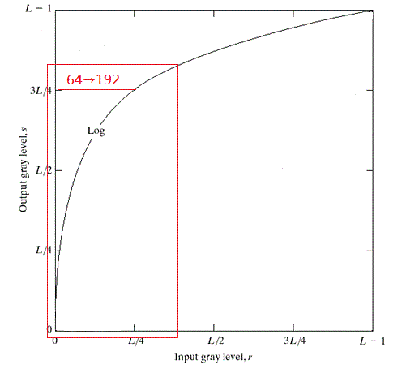
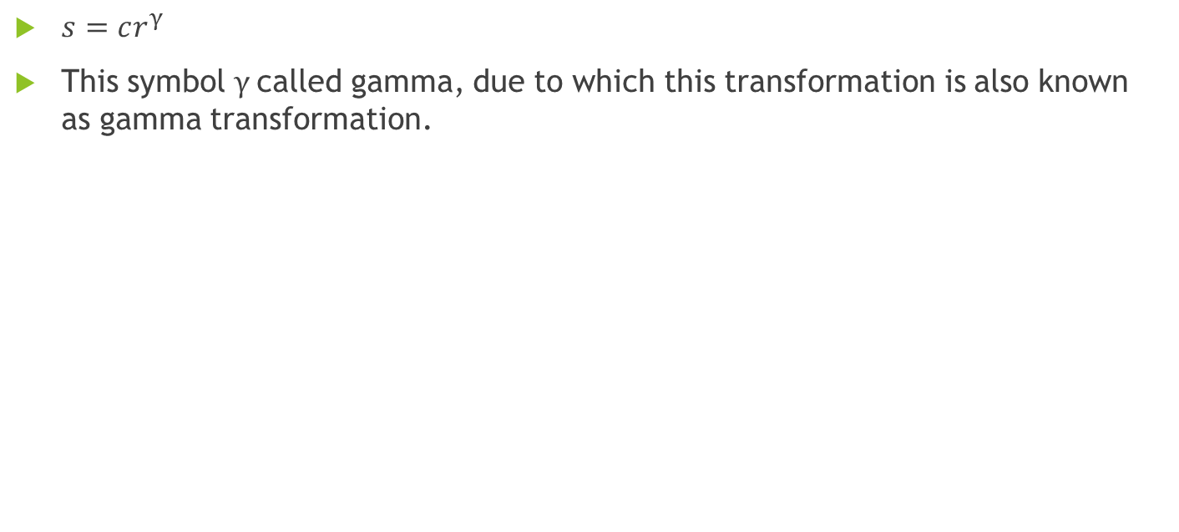
Power-Law transformation
$s=cr^{γ}$
This symbol $γ$called gamma, due to which this transformation is also known as gamma transformation.
Notes:
透過對數轉換，將過曝的照片暗一點，讓曝光度不足的照片亮一點。如圖一及圖二所示。圖二的紅色框框裡都是屬於比較暗但偏黑的部分，經過對數後，數值將會變大。s為輸出圖片，$γ$為調整值，r為輸入圖片，c為常數。

Slide 7
Thresholding
The algorithm assumes that the image contains two classes of pixels following bi-modal histogram (foreground pixels and background pixels), it then calculates the optimum threshold separating the two classes so that their combined spread (intra-class variance) is minimal, or equivalently (because the sum of pairwise squared distances is constant), so that their inter-class variance is maximal.
Notes:
Otsu是一種自動門檻值決定法則，因為Otsu是一個閥值選擇準則
所以要使用Otsu之前
我們必需取得我們要用閥值分割之狀態空間的分佈
其實這是因為Otsu就是延著「群內最小變異、群間最大變異」的思維來進行閥值的選擇

Slide 8
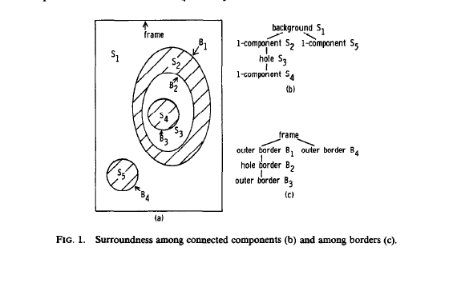
Topological structural analysis
Notes:
1985年，有個叫satoshi suzuki的人發表了一篇論文，Topological structural analysis of digitized binary images by border following，他介紹了兩種算法來實現輪廓的提取，當然輸入的圖像是二值圖像。findcontour就是基於這篇論文的思路來實現。
也許你會問，這個算法怎麼來確定外邊界，孔邊界以及他們的層級關係？他採用編碼的思想，給不同的邊界賦予不同的整數值，從而我們就可以確定它是什麼邊界以及層次關係。輸入的二值圖像即為0和1的圖像，用f(i,j)表示圖像的像素值。每次行掃描,遇到以下兩種情況終止：

Slide 9
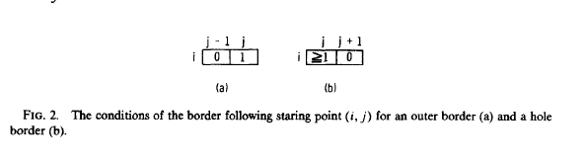
Topological structural analysis
Notes:
這張圖 起始點的敘述

Slide 10
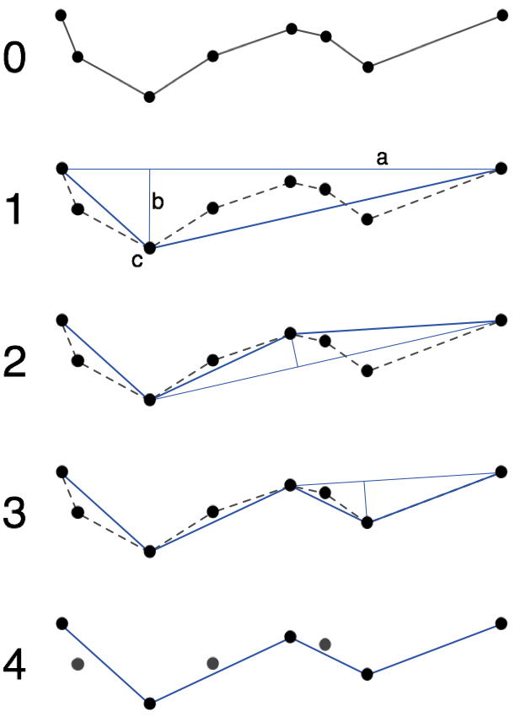
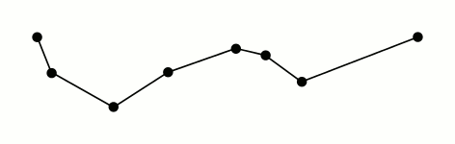
Douglas–Peucker algorithm
The algorithm makes the curve approximate as a series of points, furthermore, it can reduce the number of points.
Notes:
道格拉斯-普可算法，該算法遞歸地劃分線，最初，先由使用者設定$ε$，然後在第一點和最後一點之間點出所有線上的點，並找出第一點和最後一點作為終點線段的最遠的點，該點顯然距離端點之間的近似線段的曲線最遠。如果距離線段最遠的點大於來自近似的$ε$，則必須保持該點，如果點比線段更接近於$ε$，則可以丟棄當前未被標記為要保留的任何點，而不會使簡化曲線比$ε$更差。

Slide 11
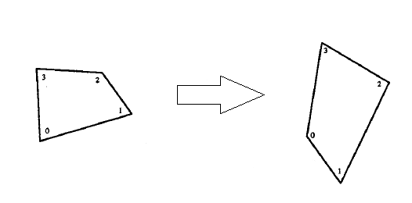
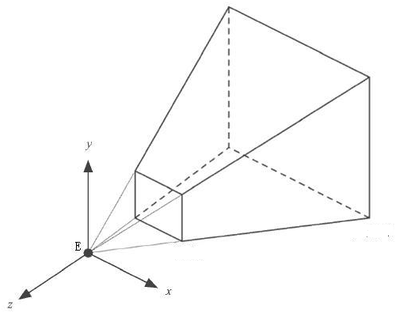
Perspective transformation
Perspective transformation is a method to transfer an image from a plan to another plan, and it also called Projective Mapping.

Slide 12
Experiment results
Load image
RGB to gray level
Power-Law
Adaptive thresholding
Morphology
Topological structural analysis
Douglas–Peucker algorithm
Perspective transformation

Slide 13
Experiment results
Load image
RGB to gray level
Power-Law
Adaptive threshold
Morphology
Topological structural analysis
Douglas–Peucker algorithm
Perspective transformation
Global Thresholding(OTSU)

Slide 14
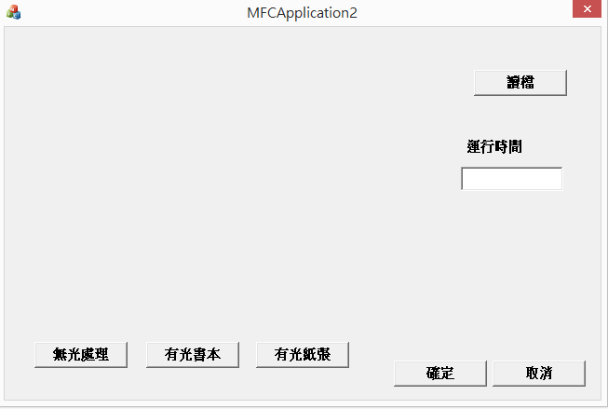
Experiment results

Slide 15
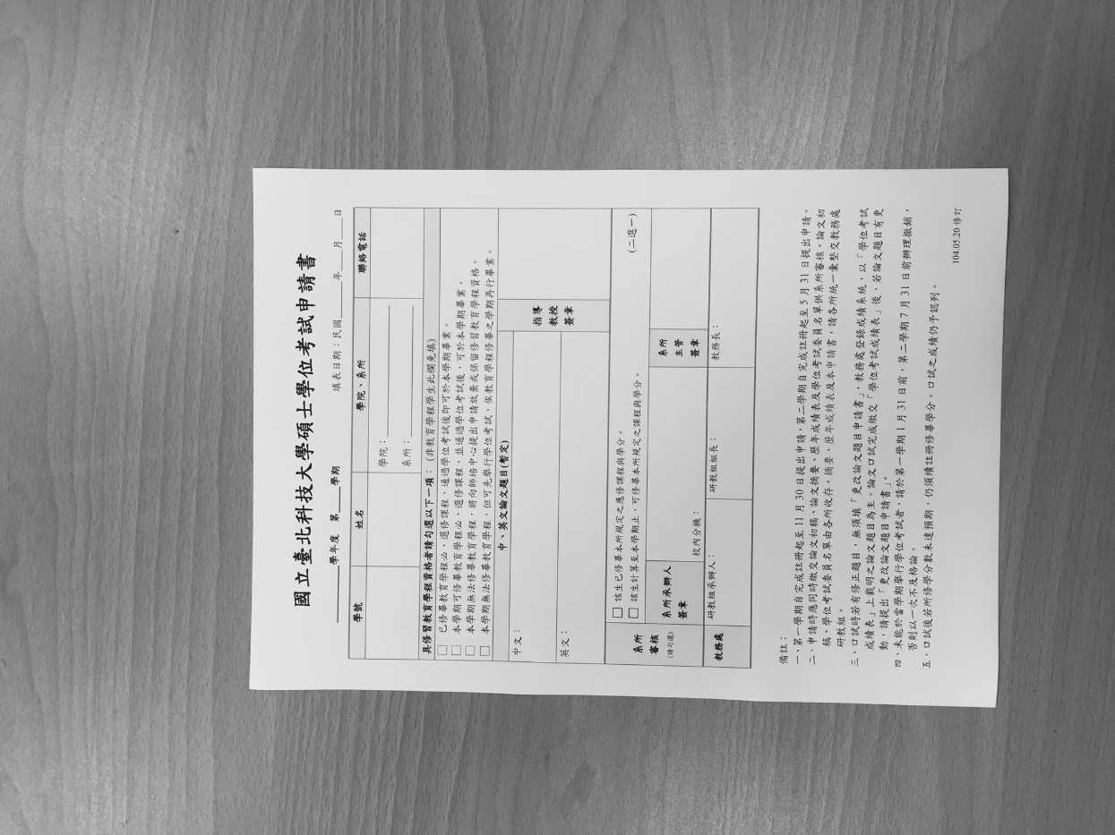
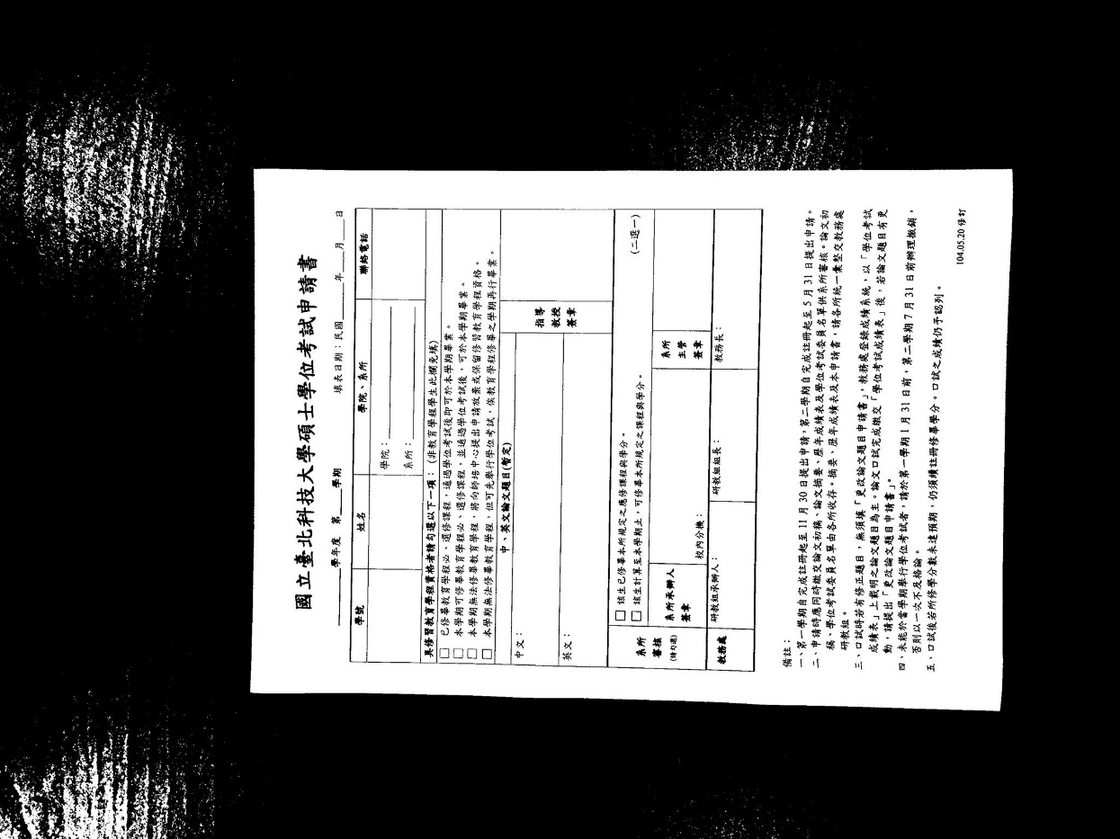
Experiment results
Notes:
RGB to gray level

Slide 16
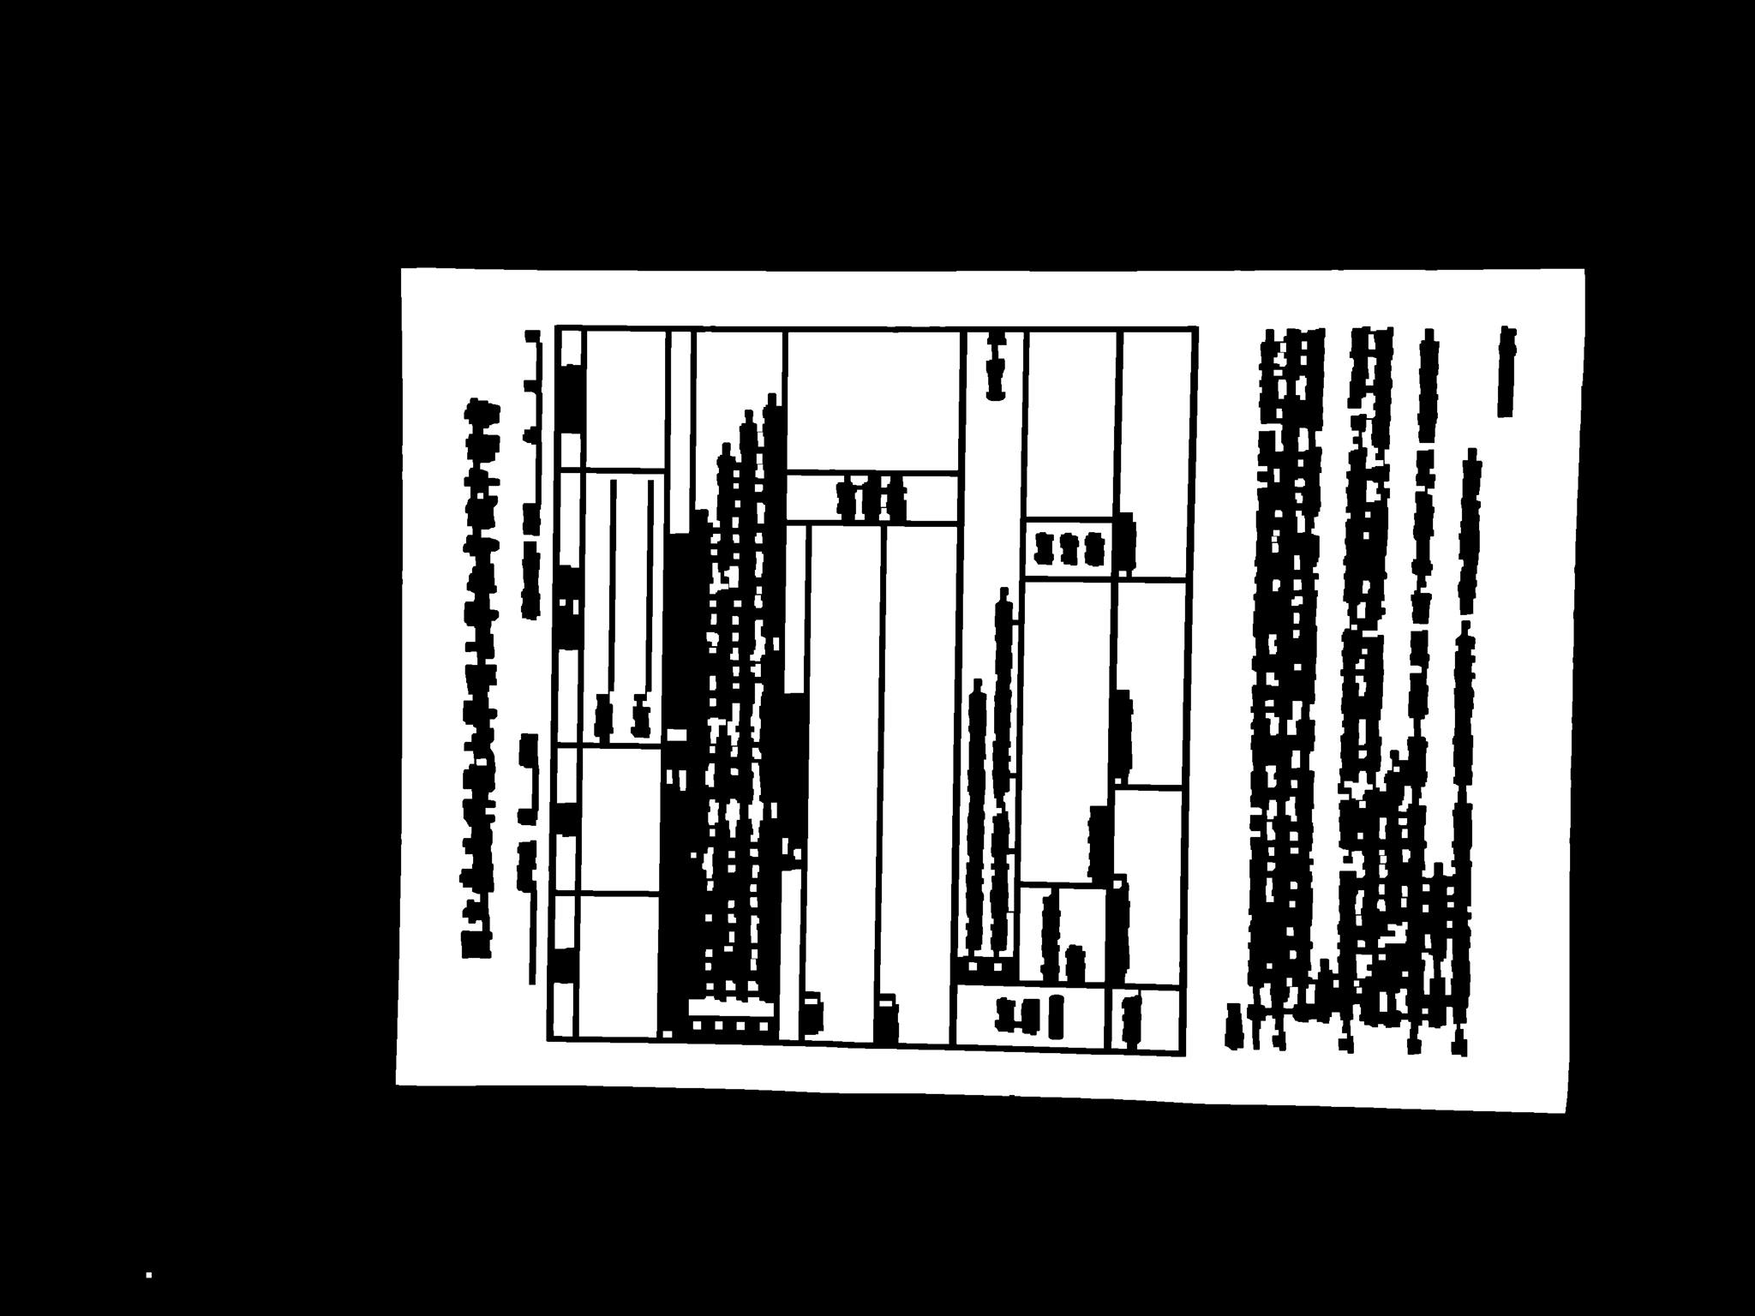
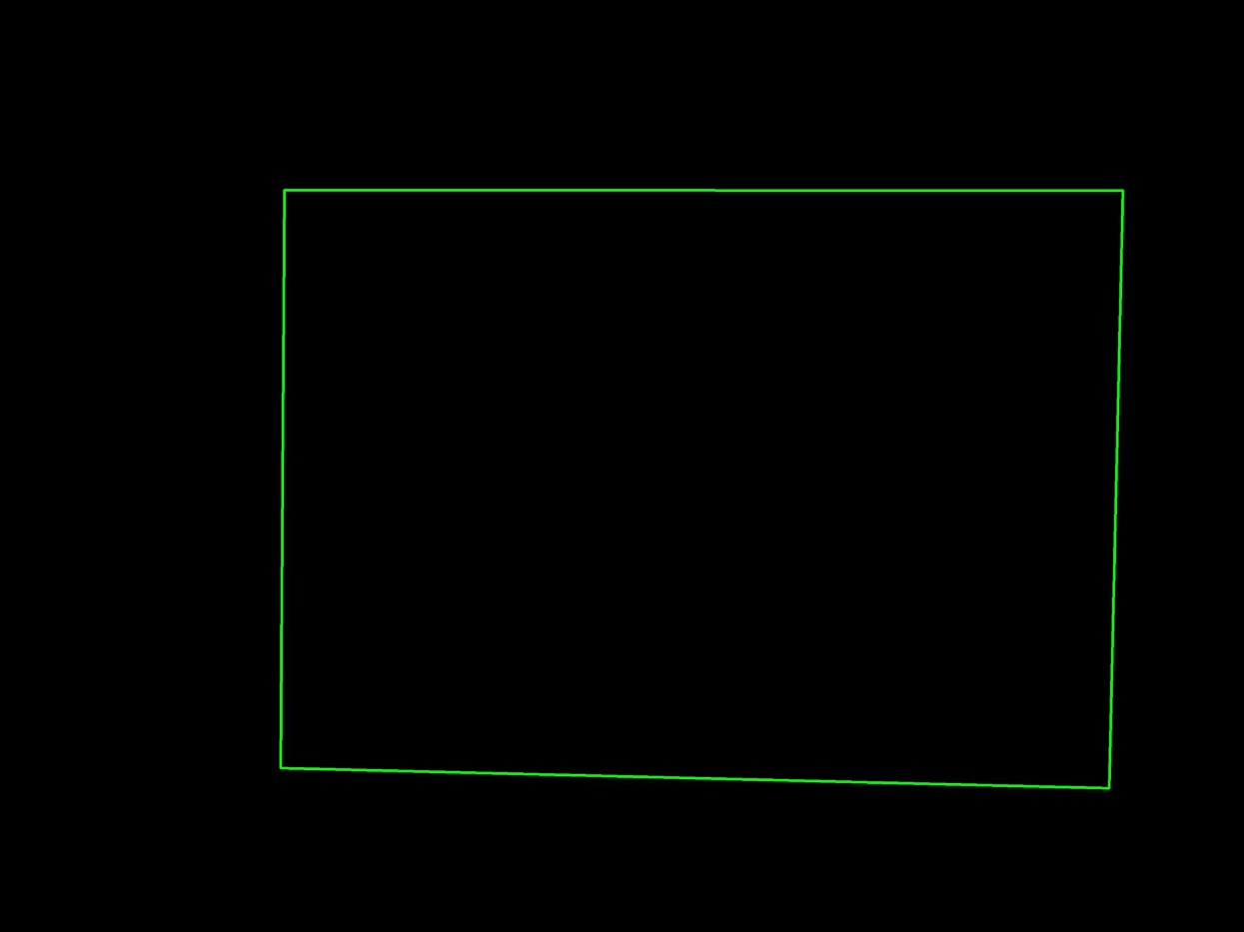
Experiment results

Slide 17
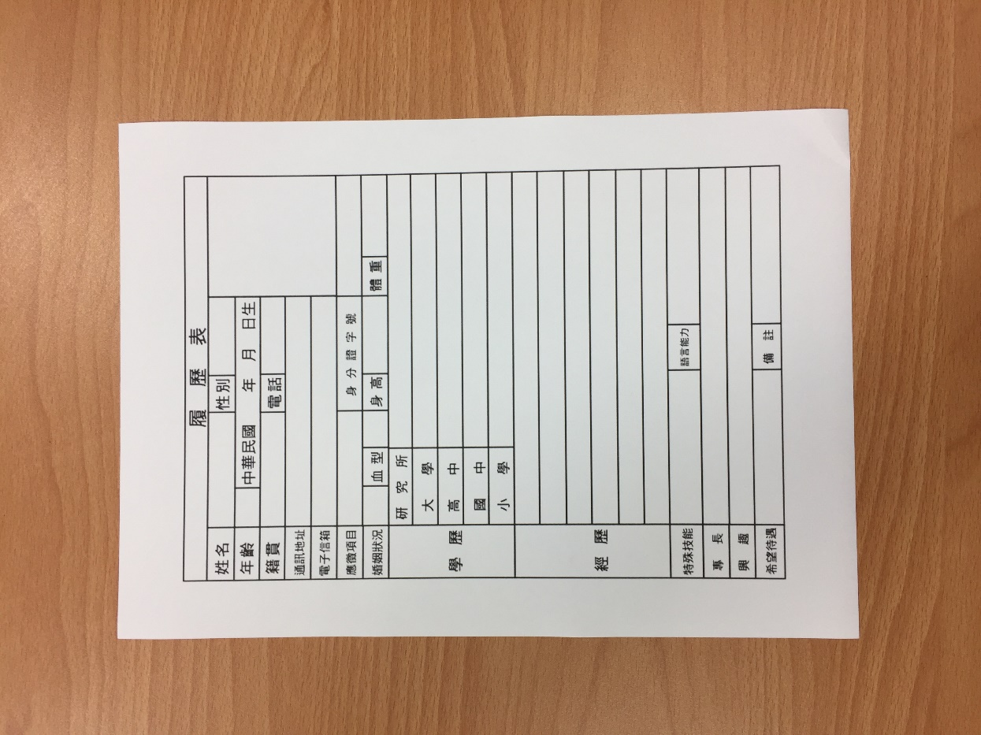
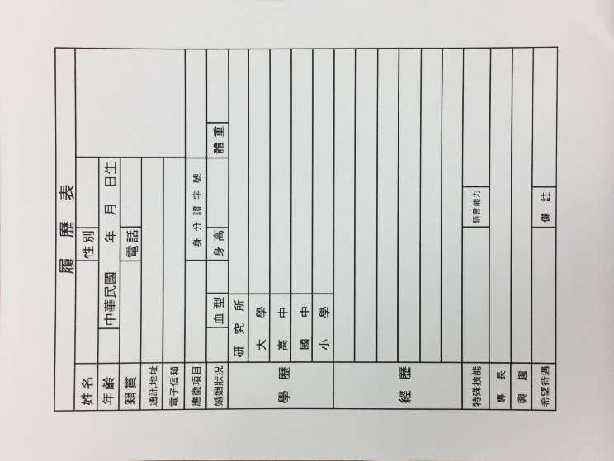
Experiment results

Slide 18
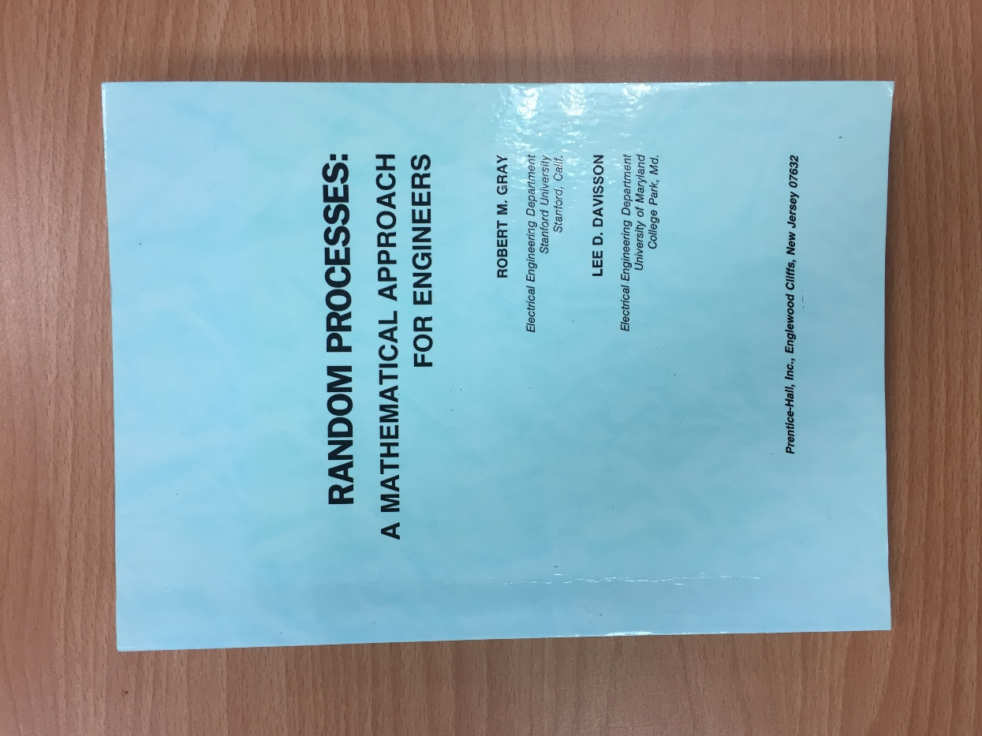
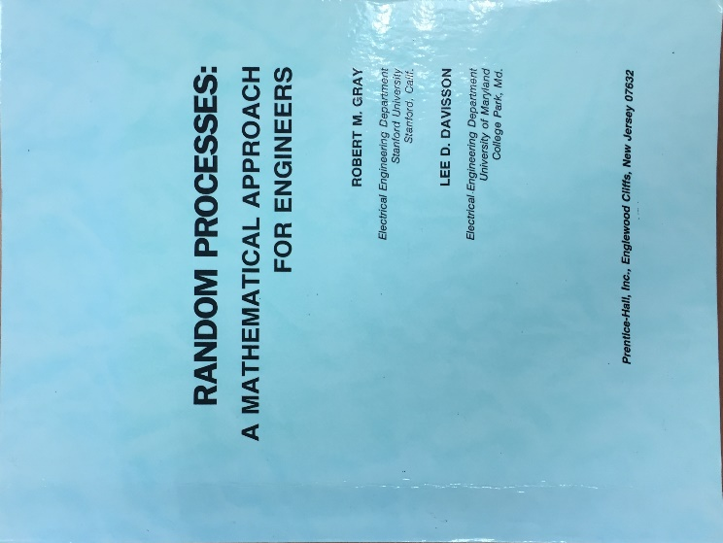
Experiment results

Slide 19
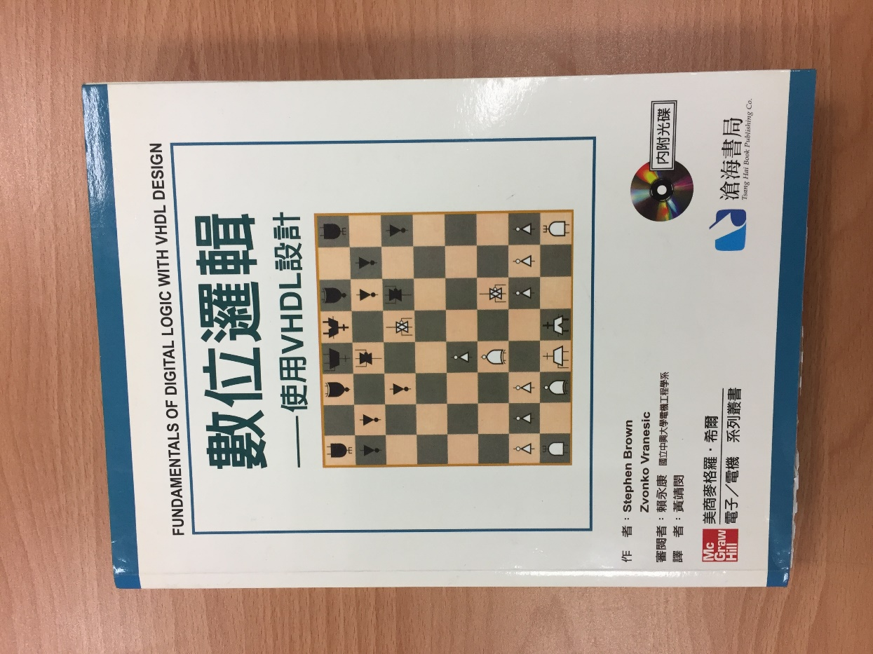
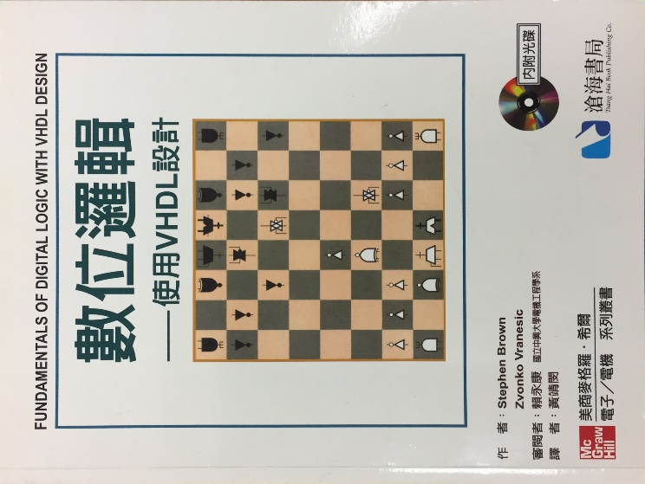
Experiment results

Slide 20
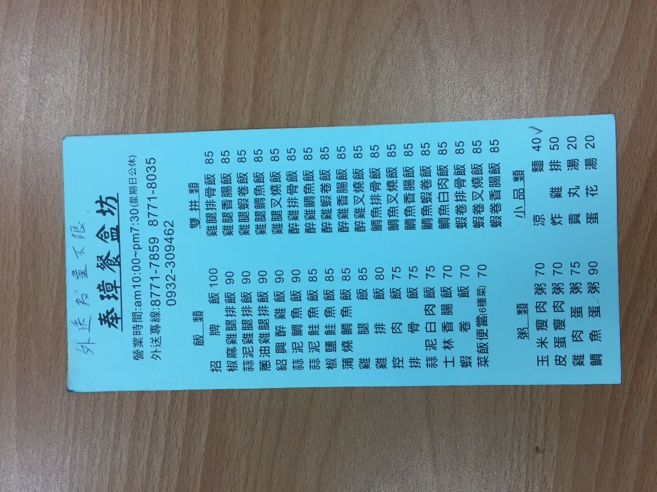
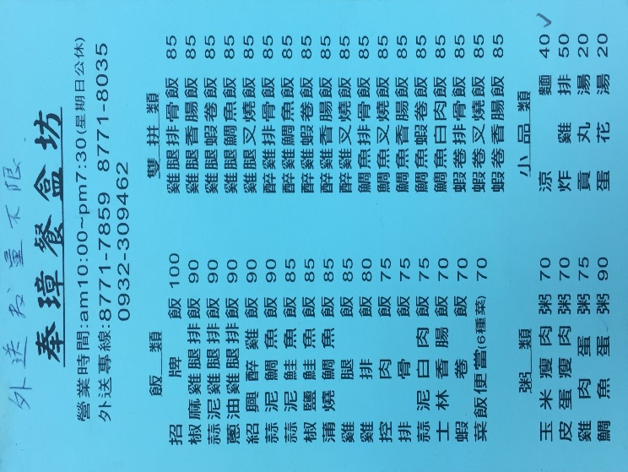
Experiment results

Slide 21
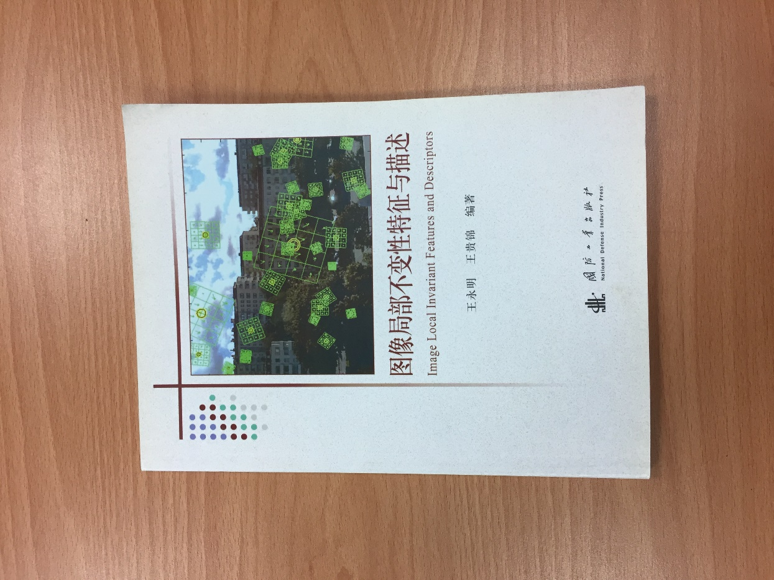
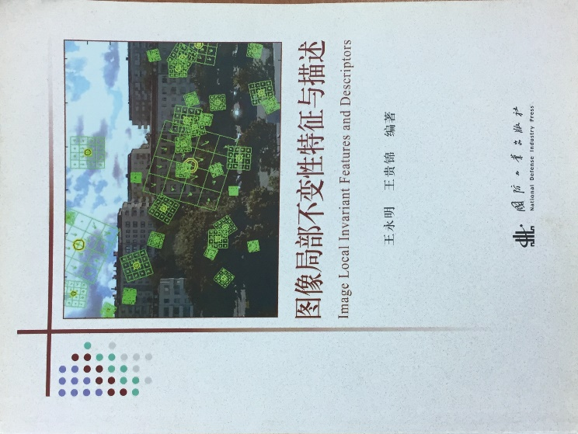
Experiment results

Slide 22
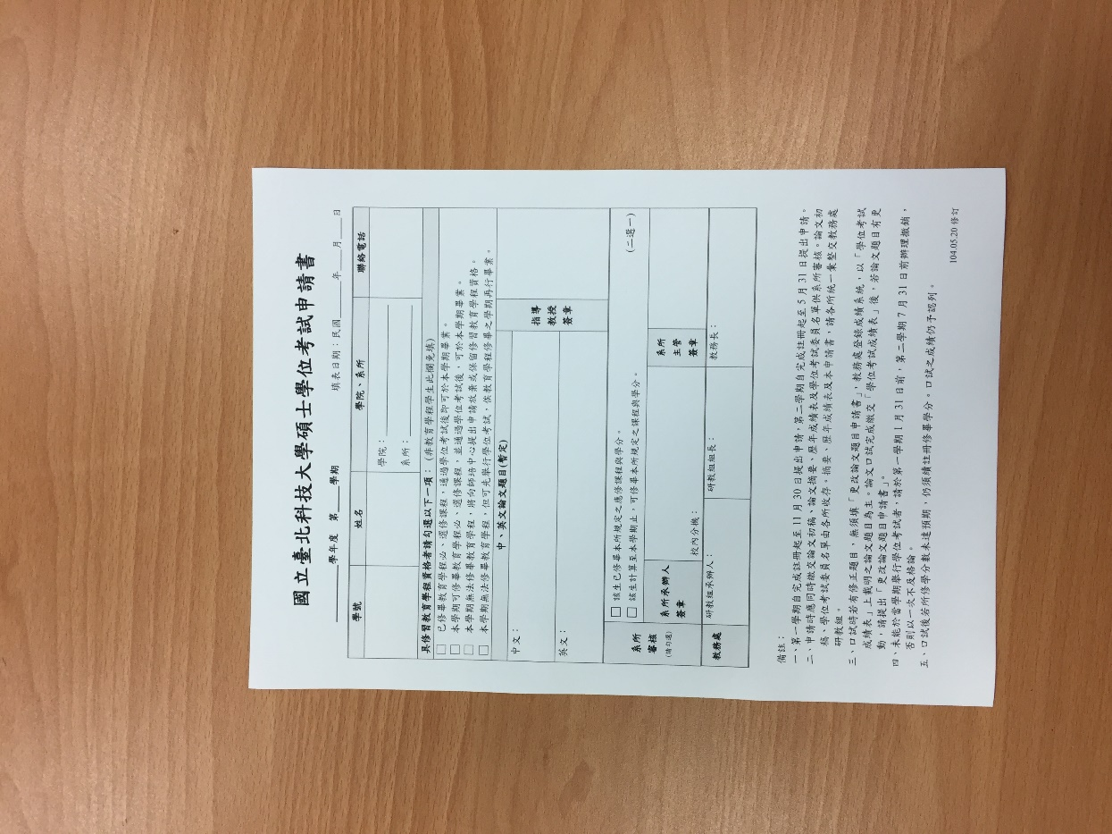
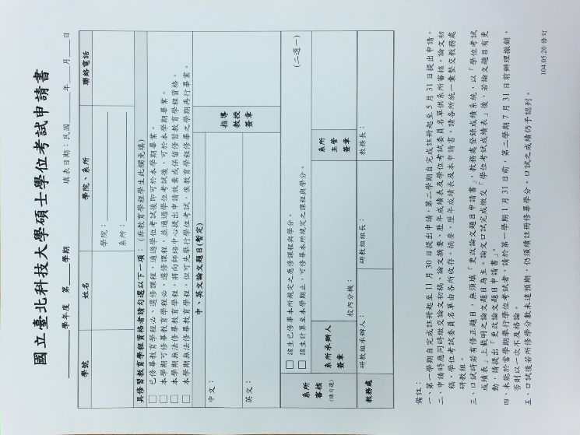
Experiment results

Slide 23
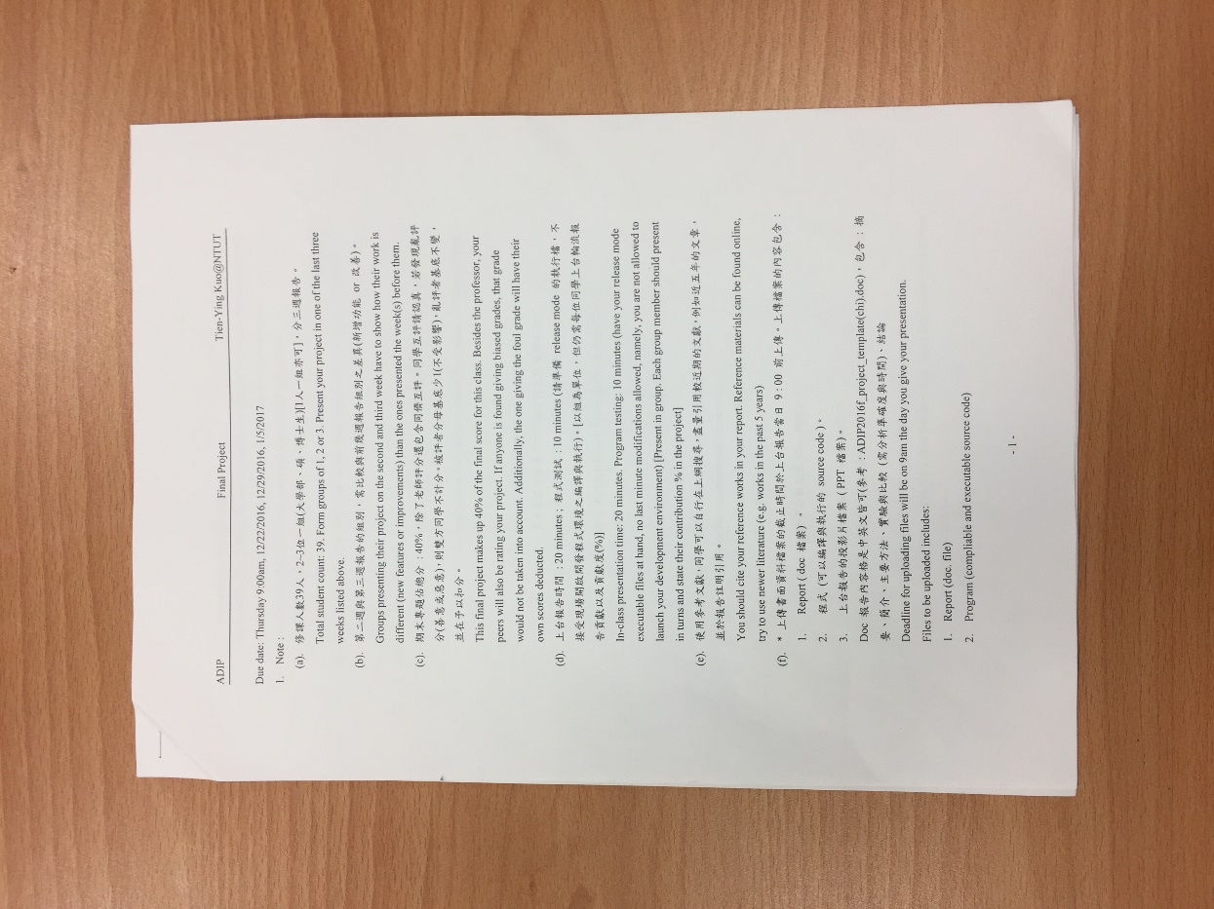
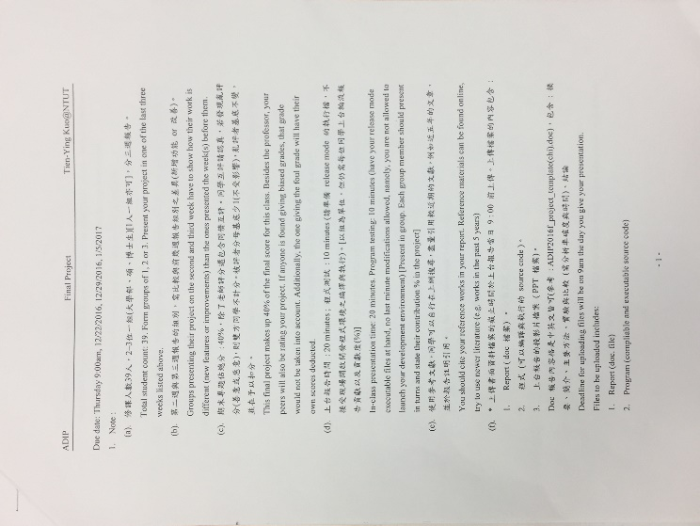
Experiment results

Slide 24
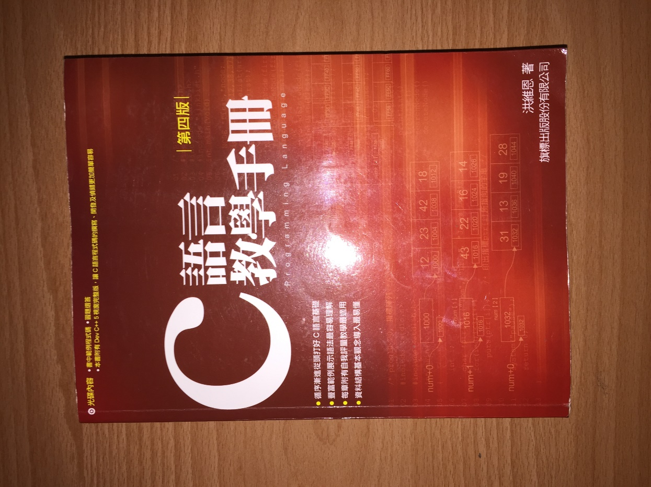
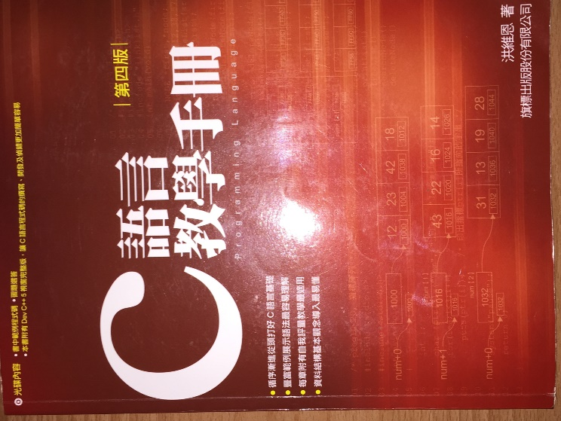
Experiment results

Slide 25
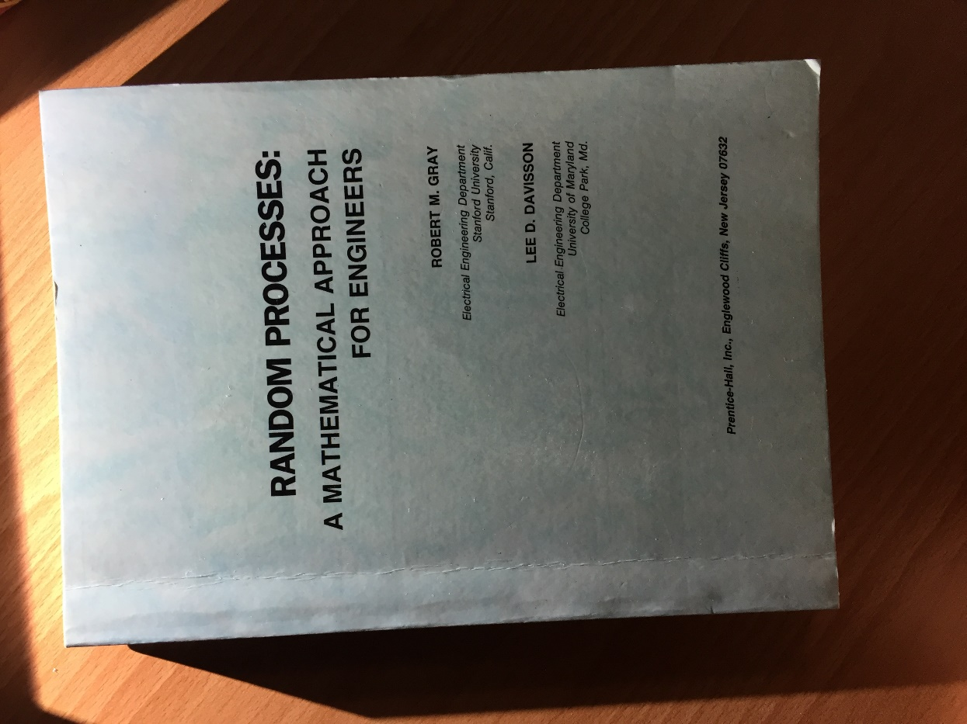
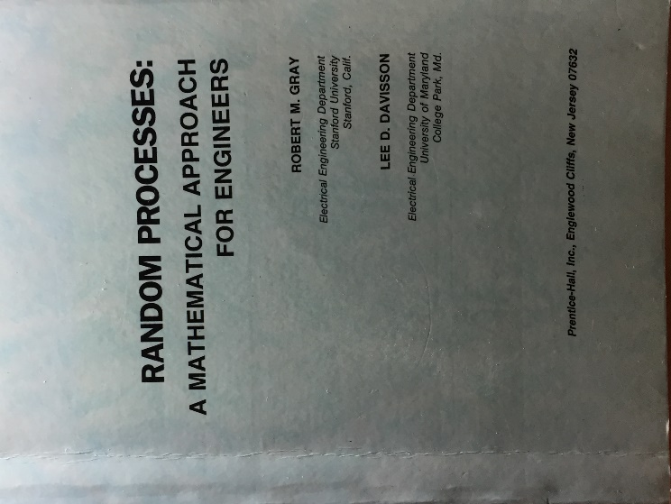
Experiment results

Slide 26
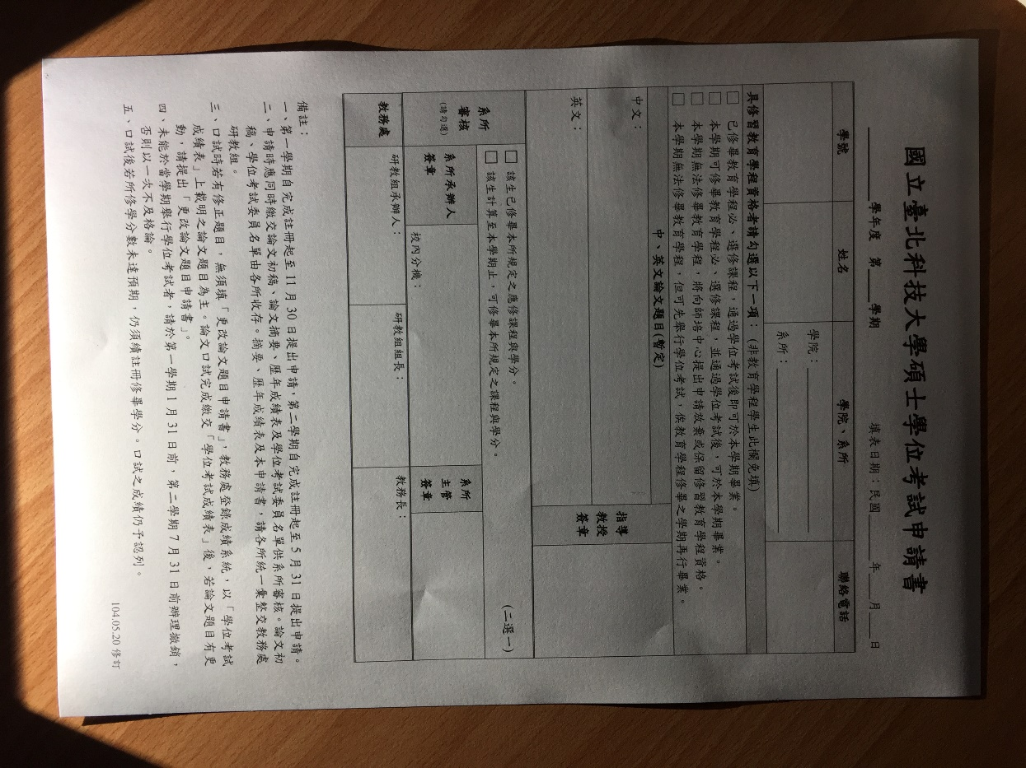
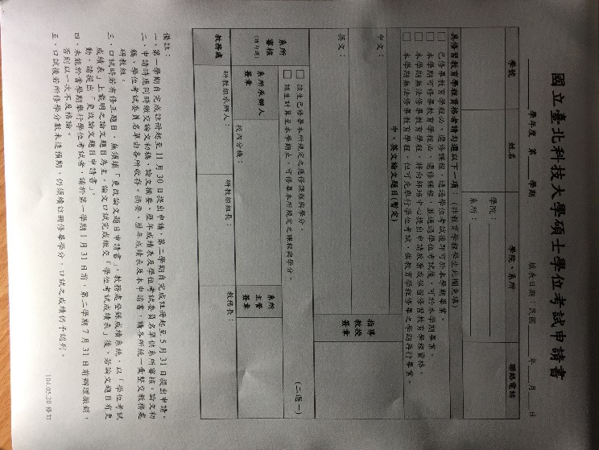
Experiment results

Slide 27
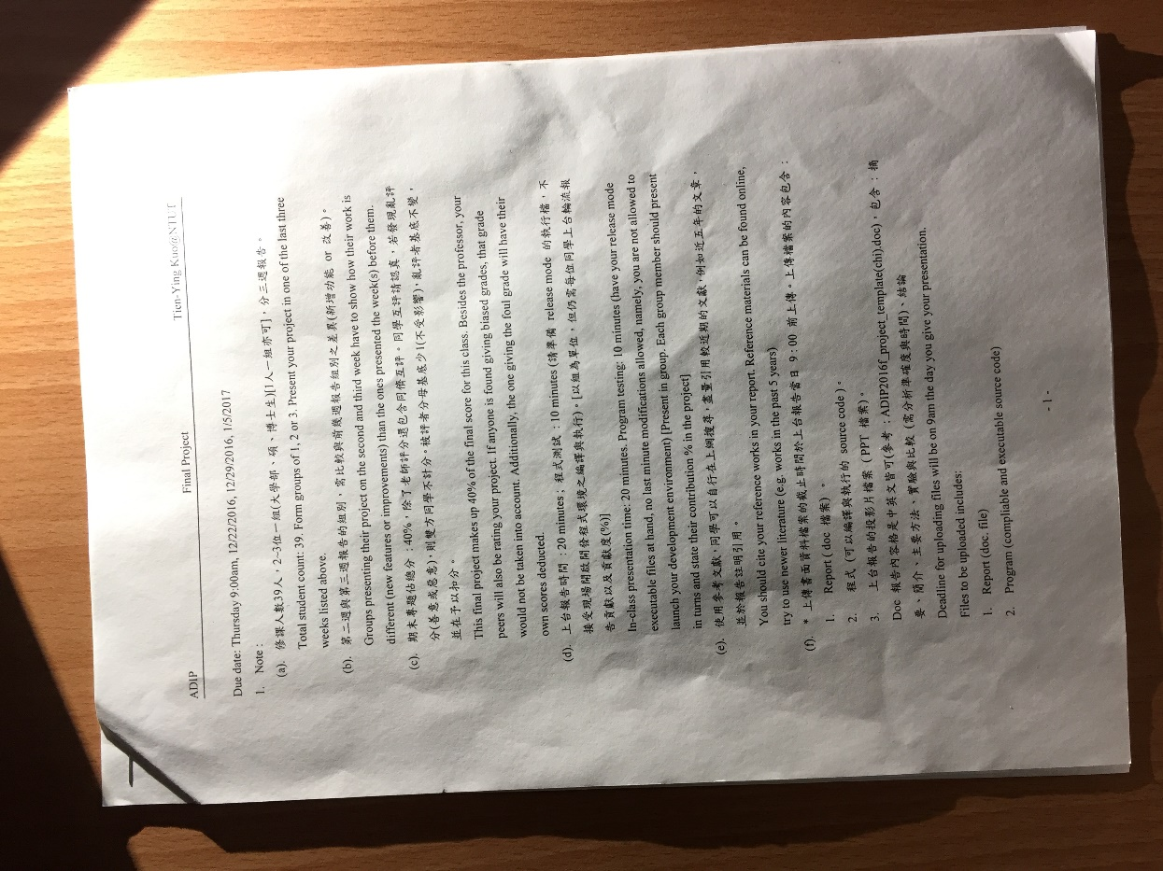
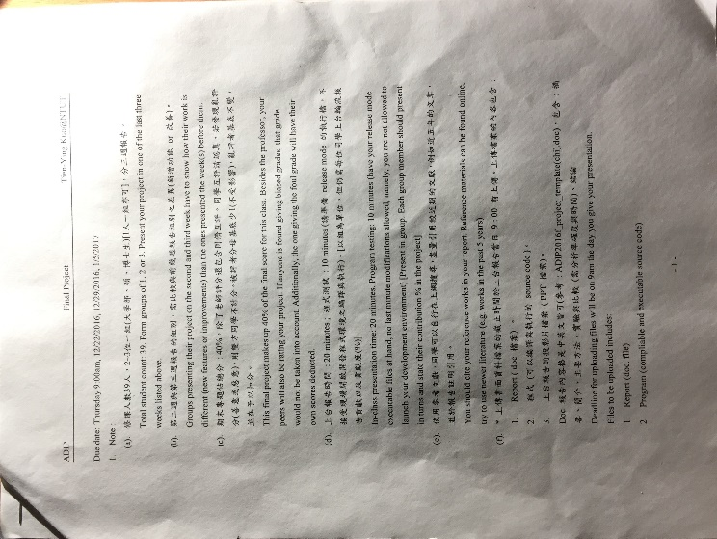
Experiment results

Slide 28
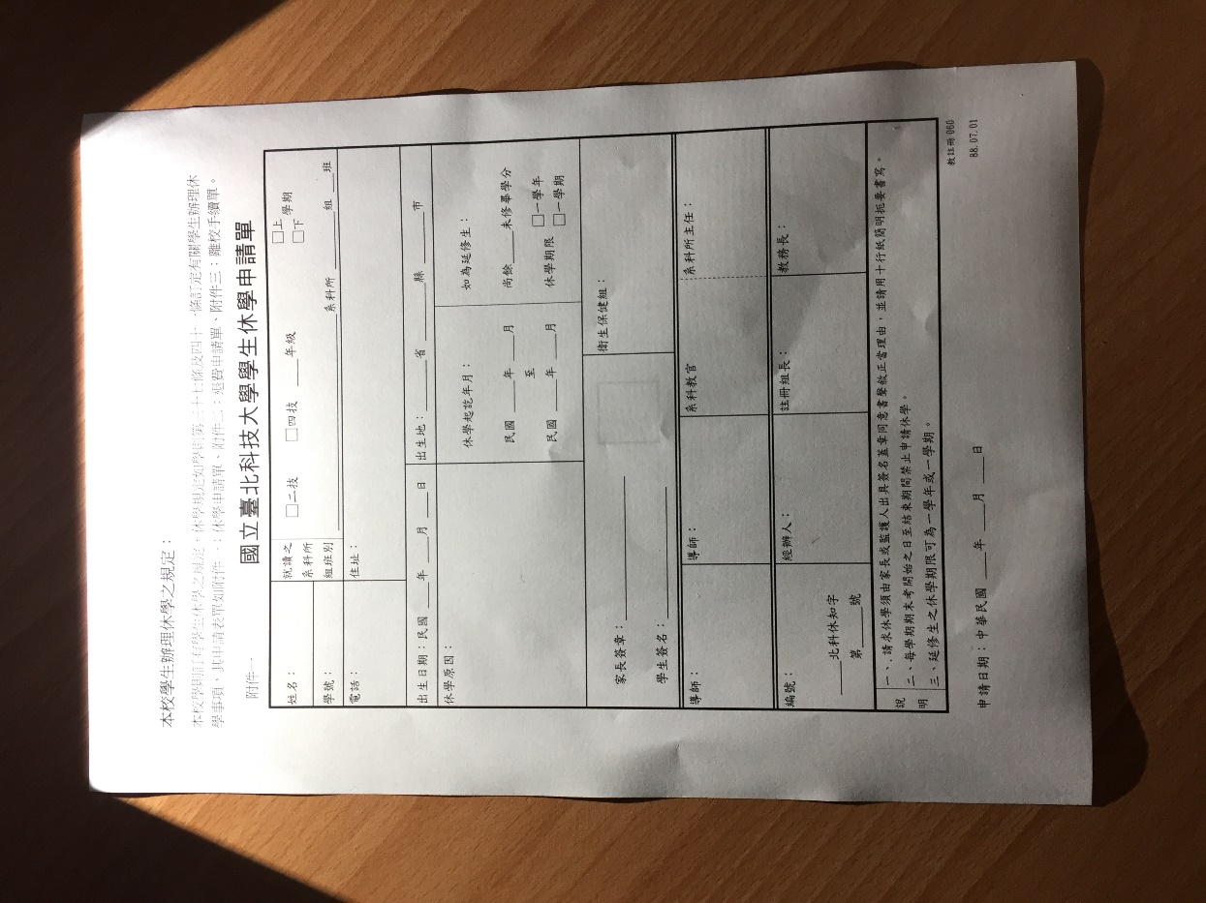
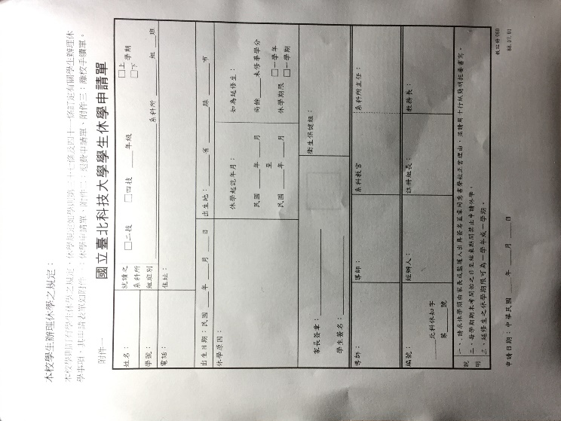
Experiment results

Slide 29
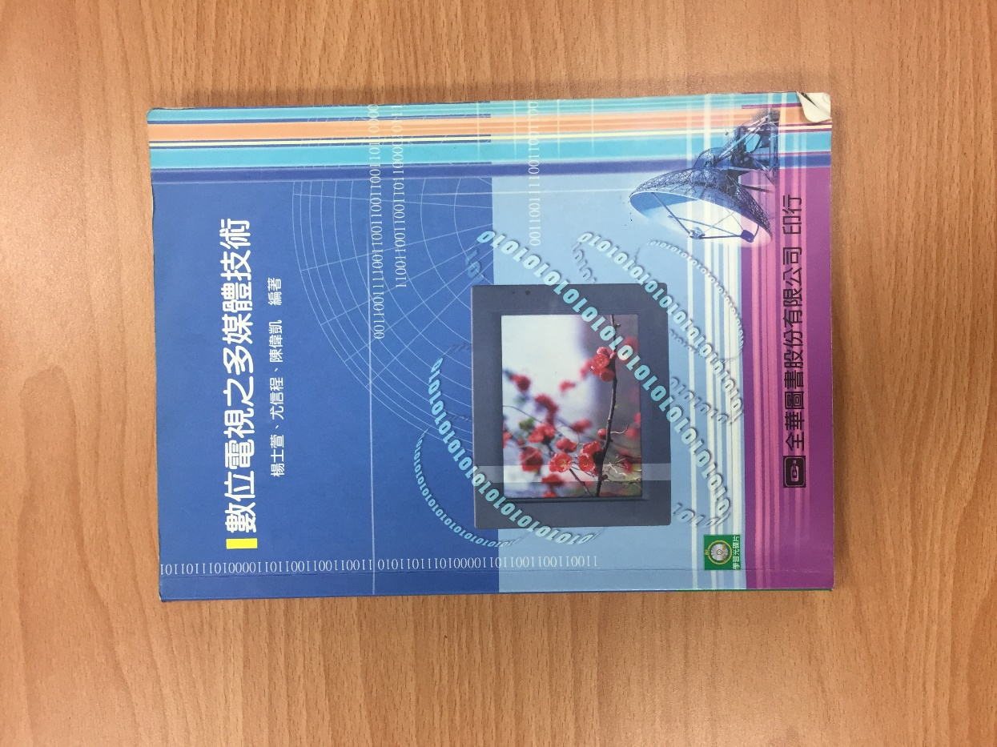
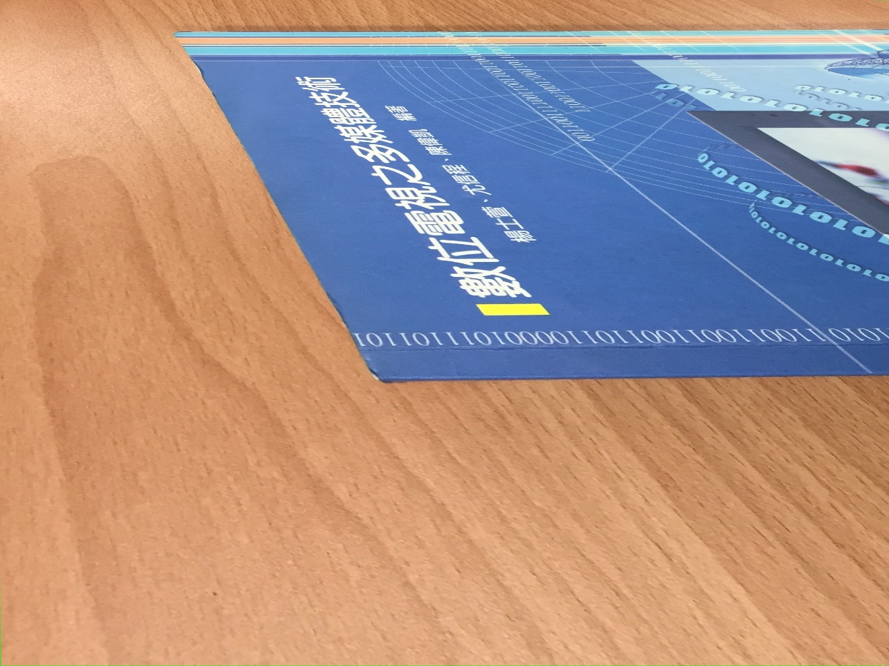
Experiment results
Notes:
失敗原因

Slide 30
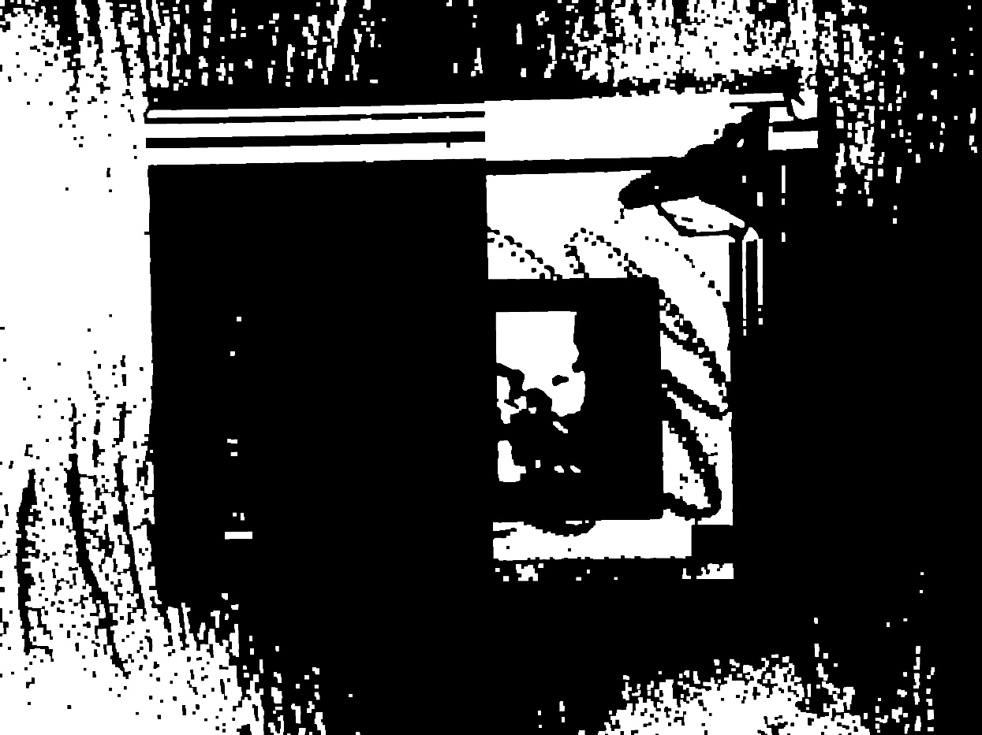
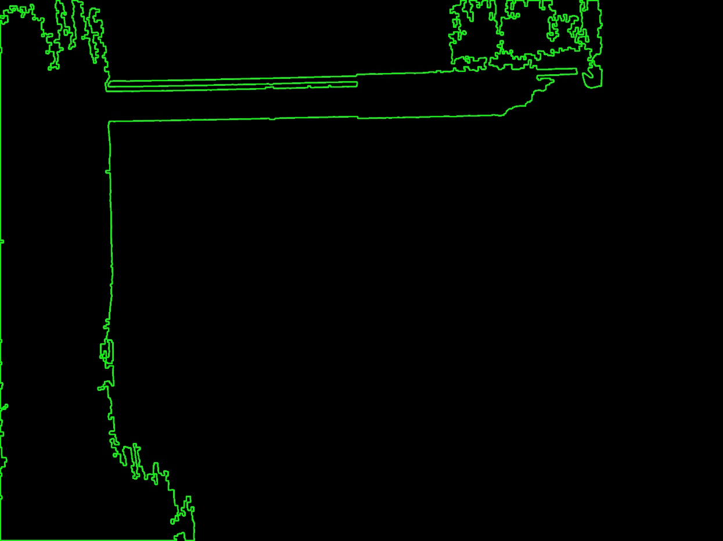
Experiment results
Notes:
失敗原因

Slide 31
Experiment results
檔名 | 時間(sec) | 是否成功
IMG_2334 | 0.313 | 是
IMG_2335 | 0.359 | 是
IMG_2337 | 0.344 | 否
IMG_2338 | 0.344 | 是
IMG_2339 | 0.328 | 是
IMG_2342 | 0.359 | 是
IMG_2343 | 0.32 | 是
IMG_2344 | 0.359 | 是
IMG_2355 | 0.969 | 是
IMG_2356 | 0.991 | 是
IMG_2358 | 0.922 | 否
IMG_2359 | 0.901 | 否
IMG_2364 | 0.985 | 是
IMG_2365 | 0.922 | 是
IMG_2366 | 0.938 | 是

Slide 32
Experiment results
No Light | Accuracy(detected pictures/total pictures)
Level 1(8 pictures) | 7 / 8 pictures
Level 2(8 pictures) | 0 / 8 pictures
Level 3(8 pictures) | 0 / 8 pictures
Total | 7 / 24 pictures
Light | Accuracy(detected pictures/total pictures)
Level 1(7 pictrues) | 5 / 7 pictures
Level 2(8 pictures) | 0 / 8 pictures
Level 3(8 pictures) | 0 / 8 pictures
Total | 5 / 23 pictures

Slide 33
Conclusion
This system is an image processing MFC application. Users can select the picture and mode he/she wants, then the application will do image processing to the picture. The key points of this program are Topological structural analysis and Douglas–Peucker algorithm. First one can find the biggest contour and second one can reduce the points on the contour. Now this program still can not do image processing to some pictures successfully, maybe we will study more paper to improve this program.

Slide 34
Reference
Mustafa Ali Abuzaraida, Salem Meftah Jebriel “The detection of the suitable reduction value of Douglas-Peucker algorithm in online handwritten recognition systems” IEEE International Conference on Service Operations And Logistics, And Informatics (SOLI),2015,pp.82-87
Rafael C. Gonzalez, Richard E. Woods, “Image Processing”,3/e, 2008, pp. 108–113.
OpenCV入門教程http://blog.csdn.net/poem_qianmo/article/details/23710721
Intel Corporation,“Open Source Computer Vision Library –Reference Manual”,2001,pp.10-6 - 10-7
阿洲的程式教學http://monkeycoding.com/?p=690#BGR_Gray
王冠智，「雲端筆記之混和式文字切割與辨識」，國立政治大學資訊科學系，2012，pp.30
逍遙文工作室https://cg2010studio.com/2013/03/22/opencv-%E9%80%8F%E8%A6%96%E8%AE%8A%E6%8F%9B-perspective-transform/
學習堅持，堅持學習-影像處理筆記https://dotblogs.com.tw/dragon229/2012/12/28/86092
S. Suzuki , K. Abe “Topological structural analysis of digitized binary images by border following” Computer Vision, Graphics, and Image Processing, Volume 30, Issue 1, 1985, pp. 32–46.

Slide 35
Contribution
 | 貢獻度 | 貢獻內容
賴笙昊 | 50% | 查詢資料、程式設計、PPT和報告撰寫
洪育佳 | 50% | 查詢資料、程式設計、PPT和報告撰寫

Slide 36
Thanks for your attention

